Slide 1
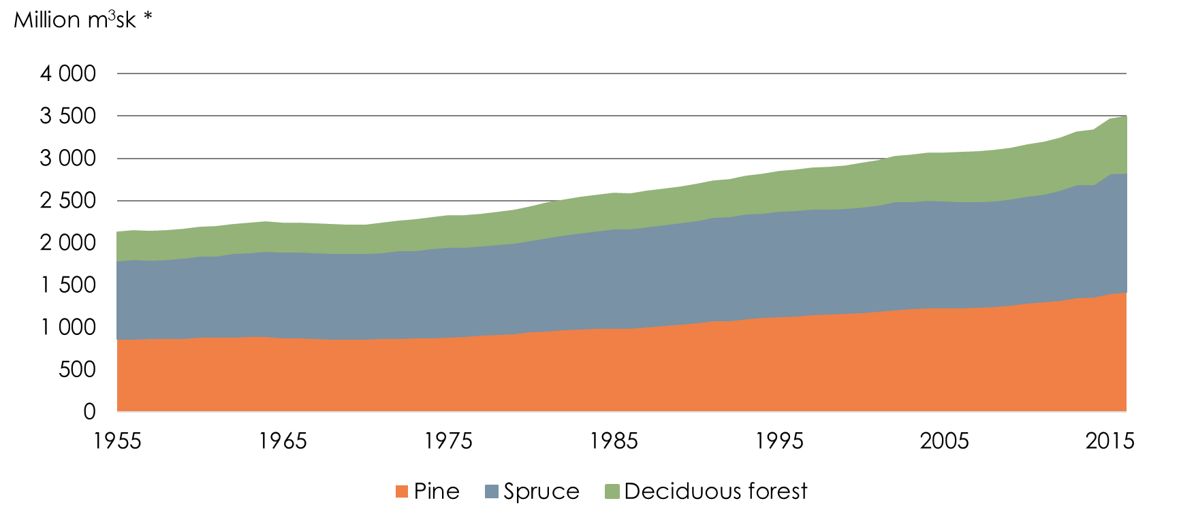
The Development of the Swedish Wood Supply*
Refers to woodland * m³sk = Forest cubic meters
Source: Swedish Forest Industries Foundation, Riksskogstaxeringen, SLU

Slide 2
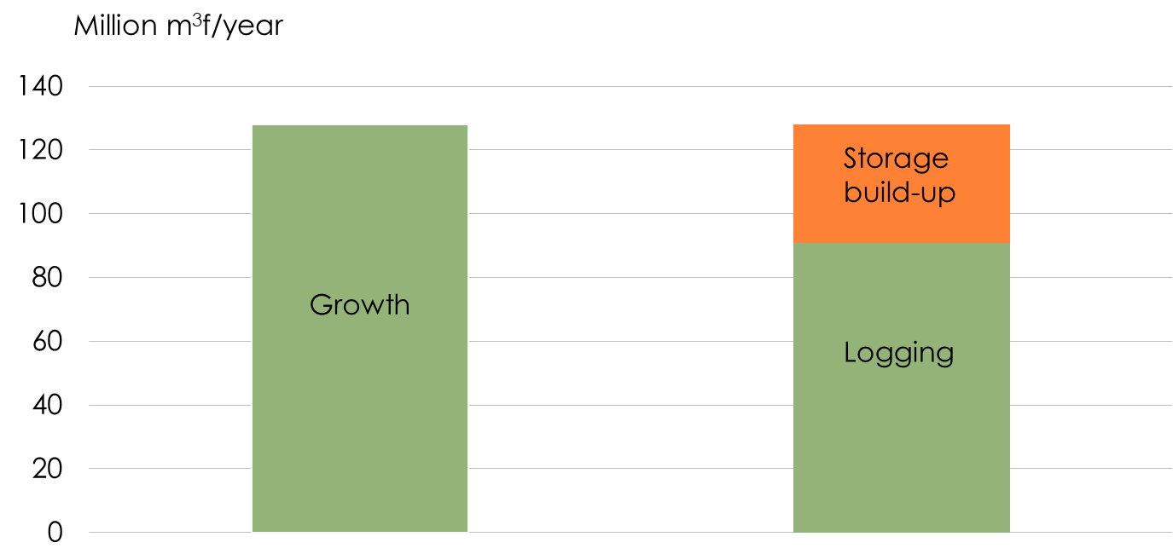
The Growth is Greater than the Harvested Areal
* m³f = Forest cubic meters
Source: Swedish Forest Industries Foundation, Riksskogstaxeringen, Skogsstyrelsen

Slide 3
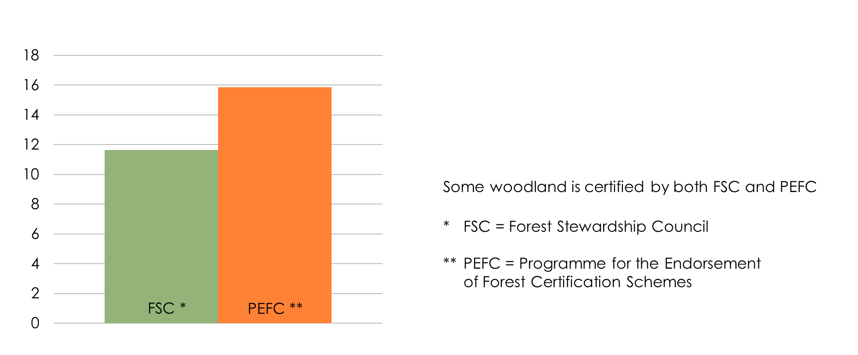
Certification
Millions of hectares
Source: Swedish Forest Industries Foundation, FSC och PEFC

Slide 4
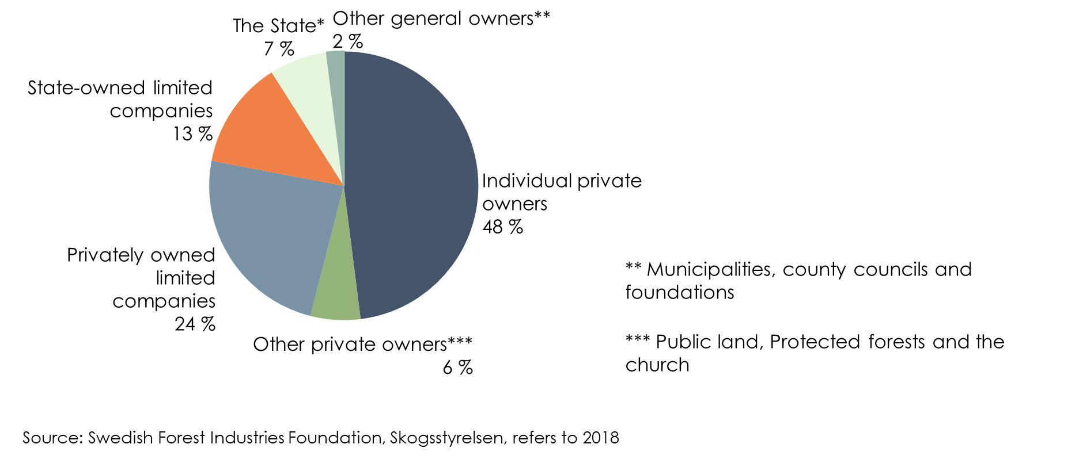
Forest Land Distribution by Owner Categories

Slide 5
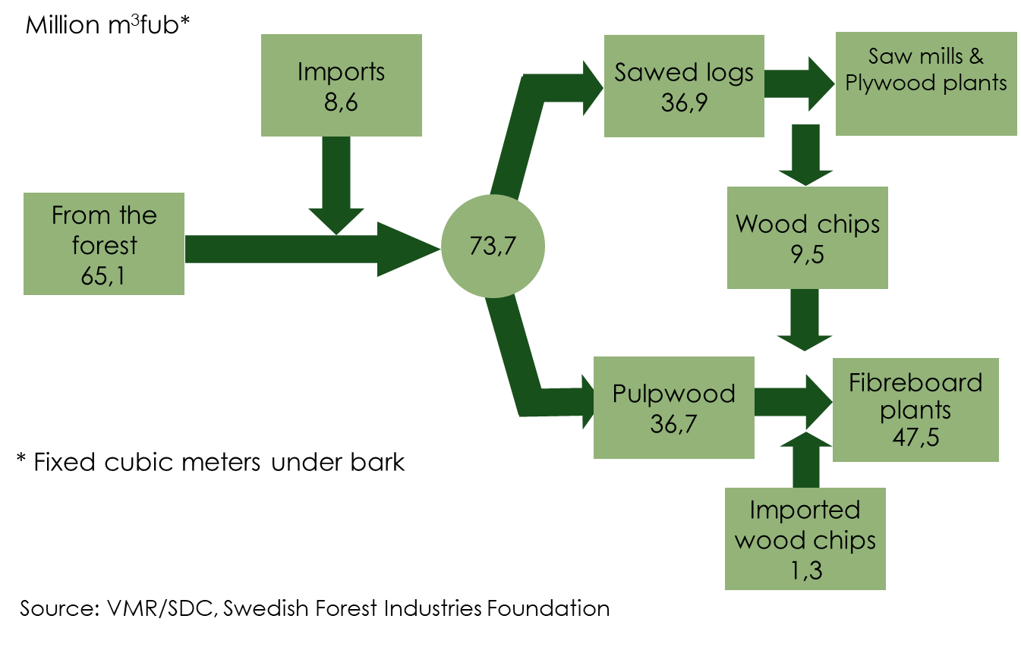
The Forest Industry’s Timber Supply 2018

Slide 6
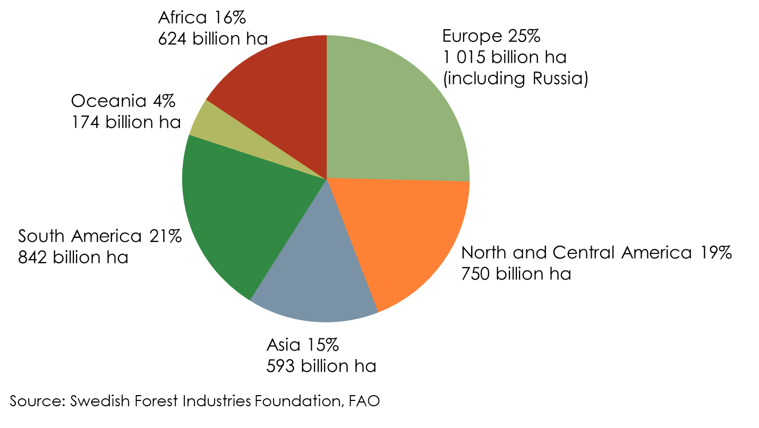
The Worlds Forests
Total area in the world: 4 billion hectares

Slide 7
Wood Use in the World 2018
Source: Swedish Forest Industries Foundation, FAO

