Slide 1
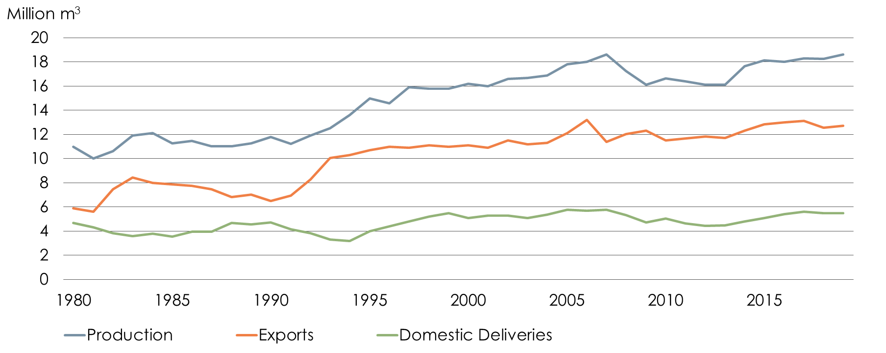
Production and Deliveries 1980-2019 Sawn Softwood
Source: Swedish Forest Industries Federation, Statistics Sweden
Production 2019: 18.6 Million m³ (2018: 18,3)
Exports 2019: 12.7 Million m³ (2018: 12,4)

Slide 2
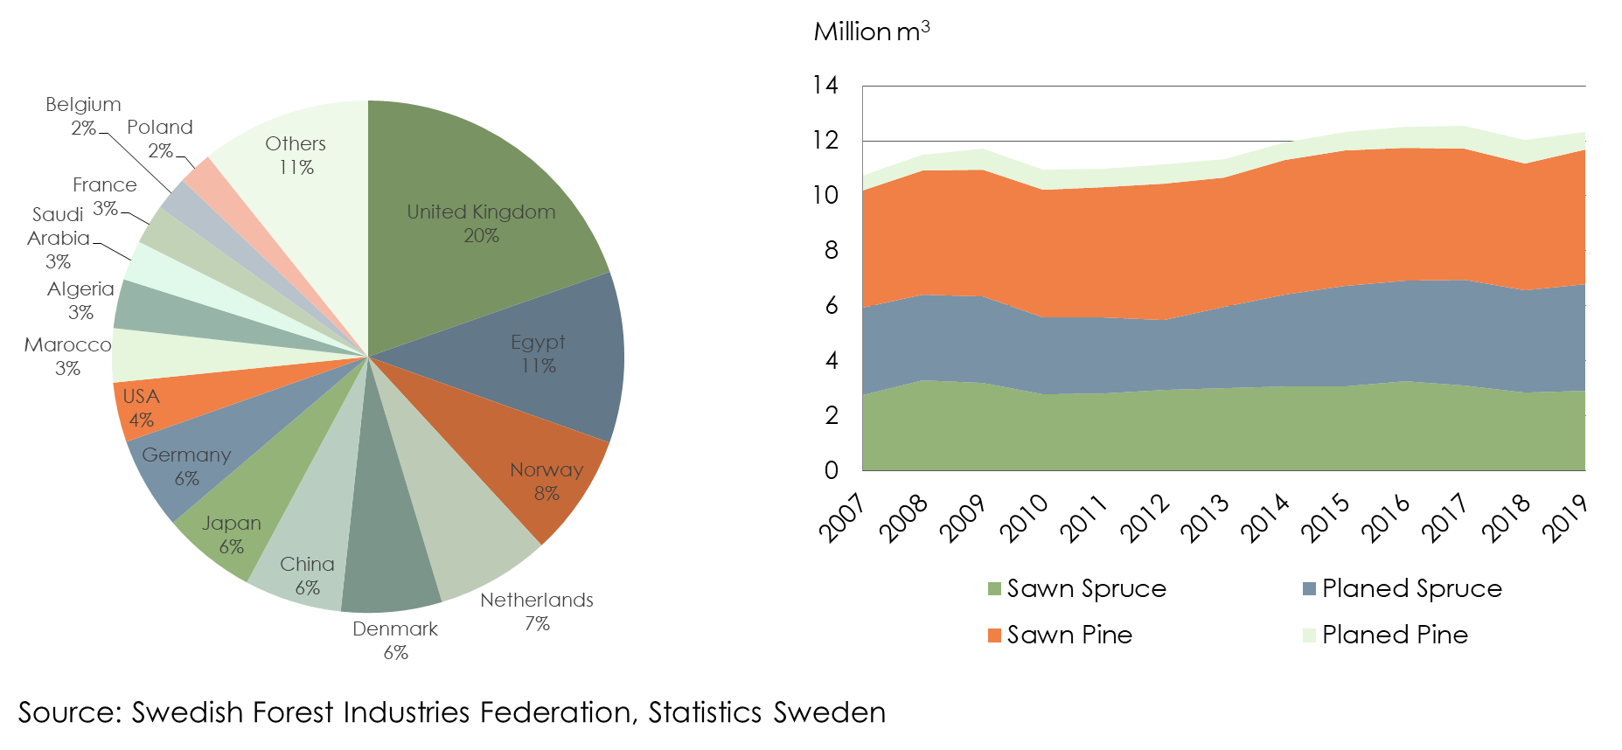
Swedens Exports of Sawn Softwood by Market och Product
Total Exports 2019: 12.7 Million m³ (2018: 12,4)

Slide 3
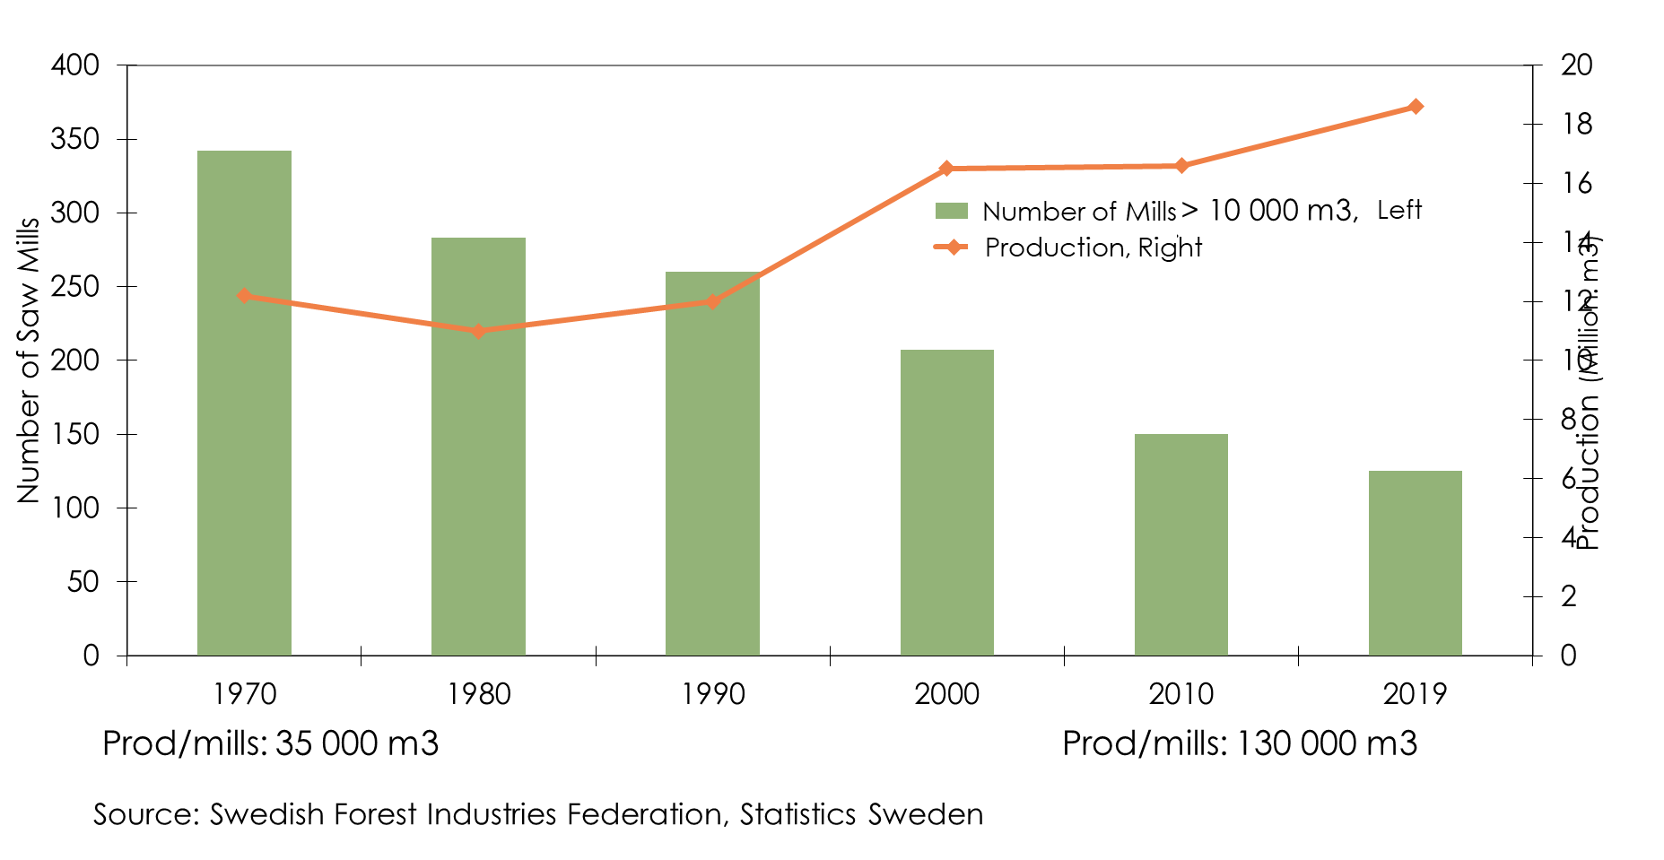
Structure Development in the Swedish Saw Mill Industry

Slide 4
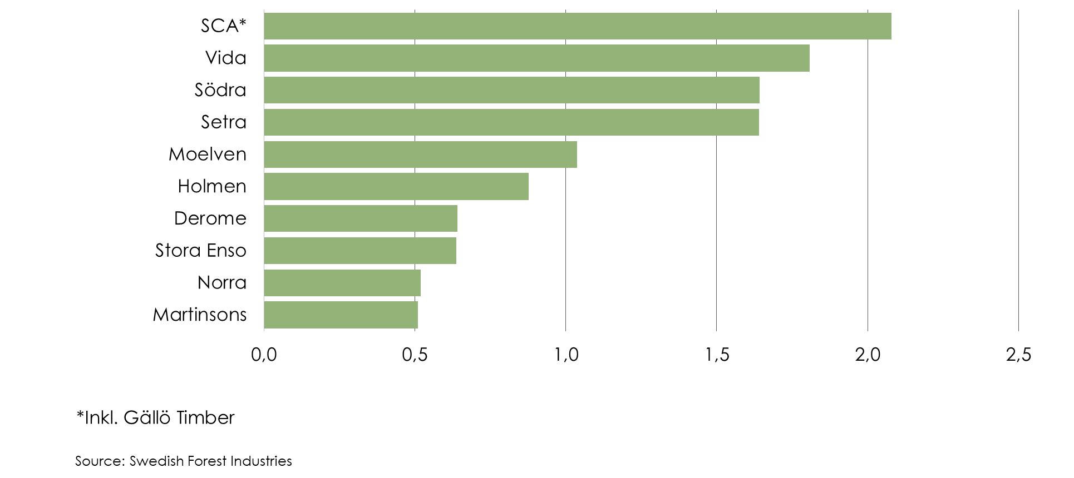
Swedens Largest Producers of Sawn Softwood, Production 2019
Millons m³

