Slide 1
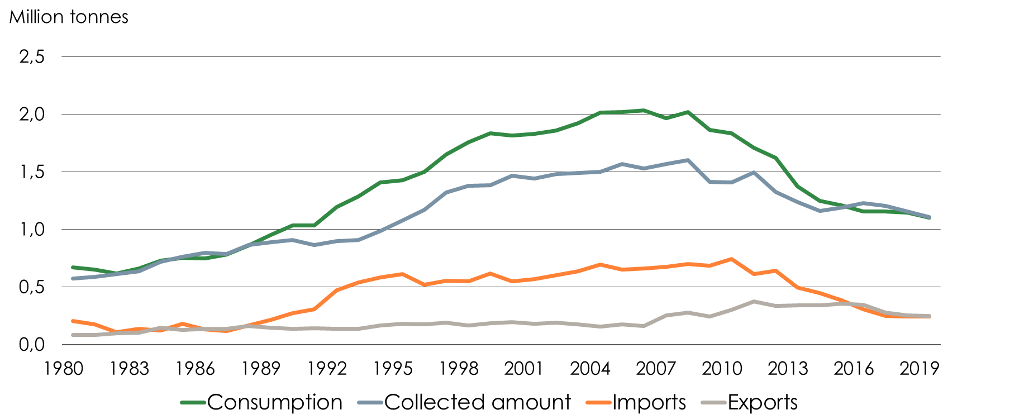
Recovered Paper in Sweden 1980-2019

Slide 2
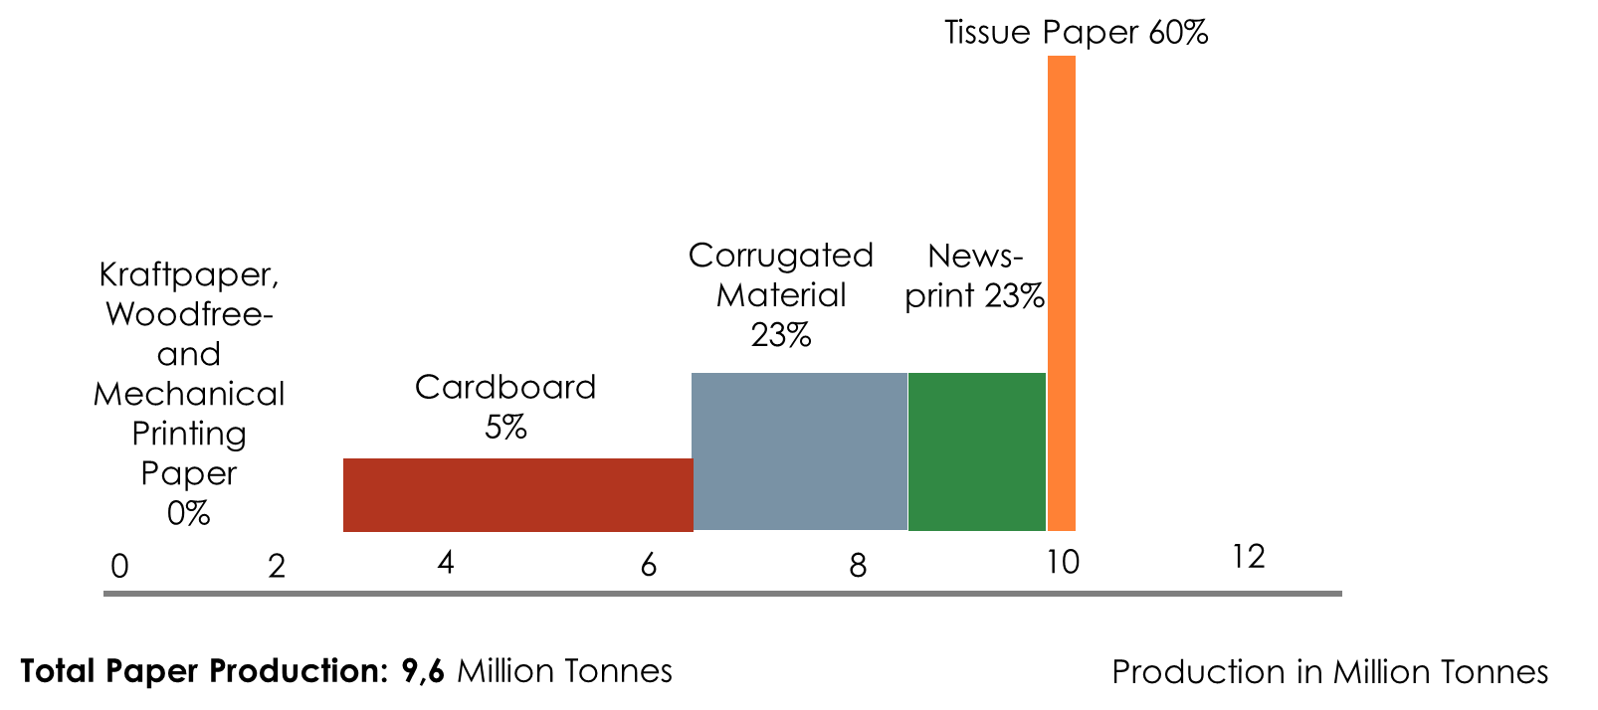
Interference Grade of Recovery Paper 2019 Different Paper Qualities
Source: Swedish Forest Industries Federation

Slide 3
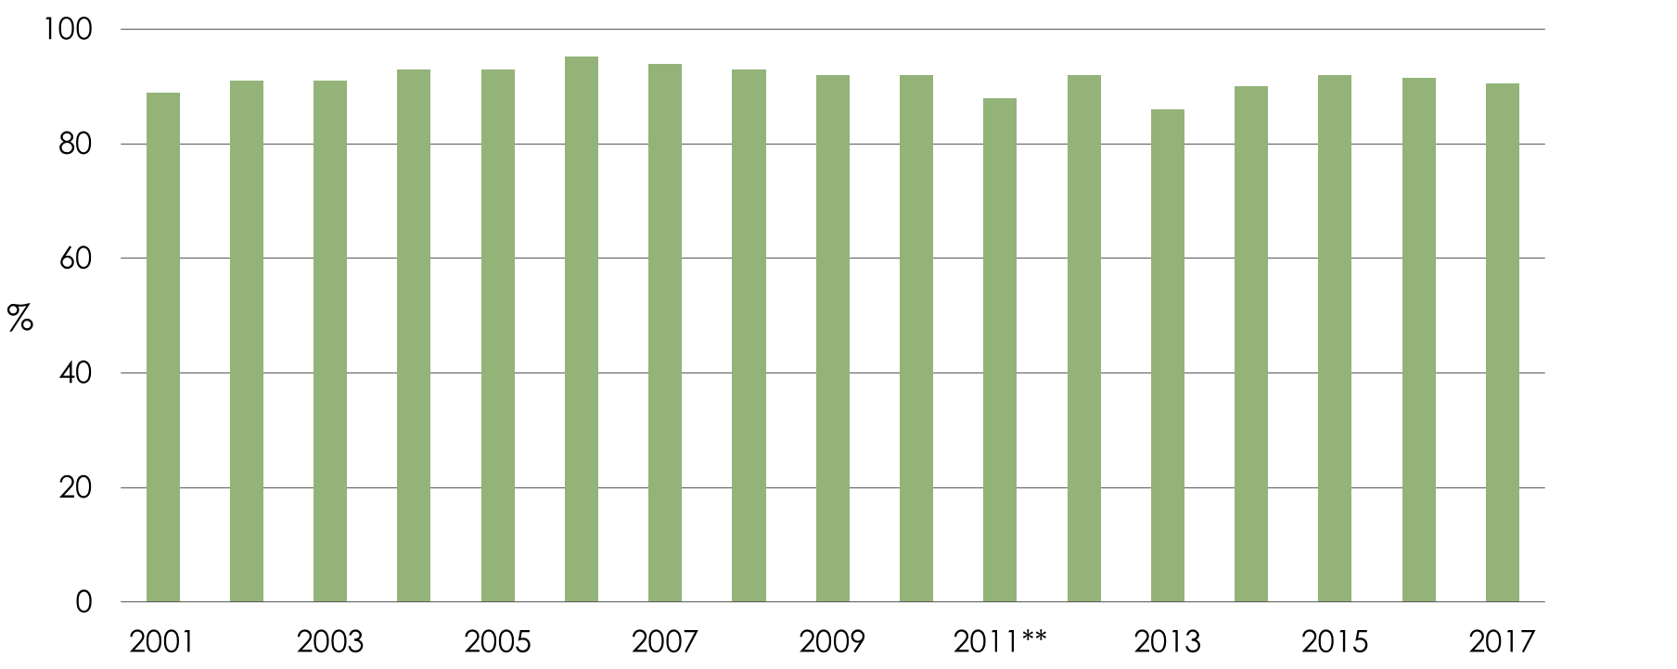
Recycling* of Waste Materials 2001-2018 From the Swedish Pulp- and Paper Industry
*Percentage of material and energy recycling and other recovery of the total amount of waste, dry weight.
**As of 2011, bark is not included.
Source: Swedish Forest Industries Federation´s environmental database

Slide 4
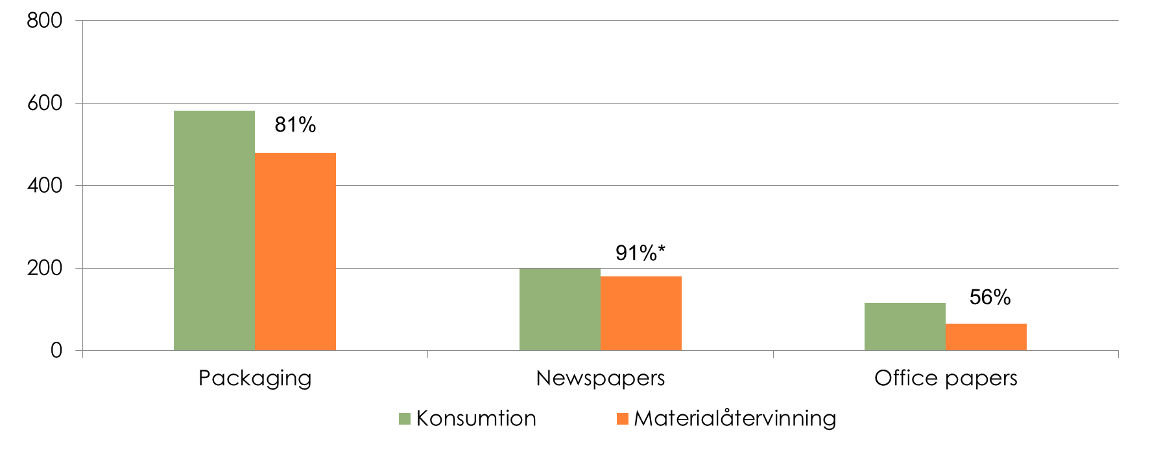
Consumption and Material Recycling of Paper 2018 as well as the percentage of material recycling as a percentage of consumption
* Estimated material recycling
Source: Förpacknings och Tidningsinsamlingen, Swedish Forest Industries Federation

Slide 5
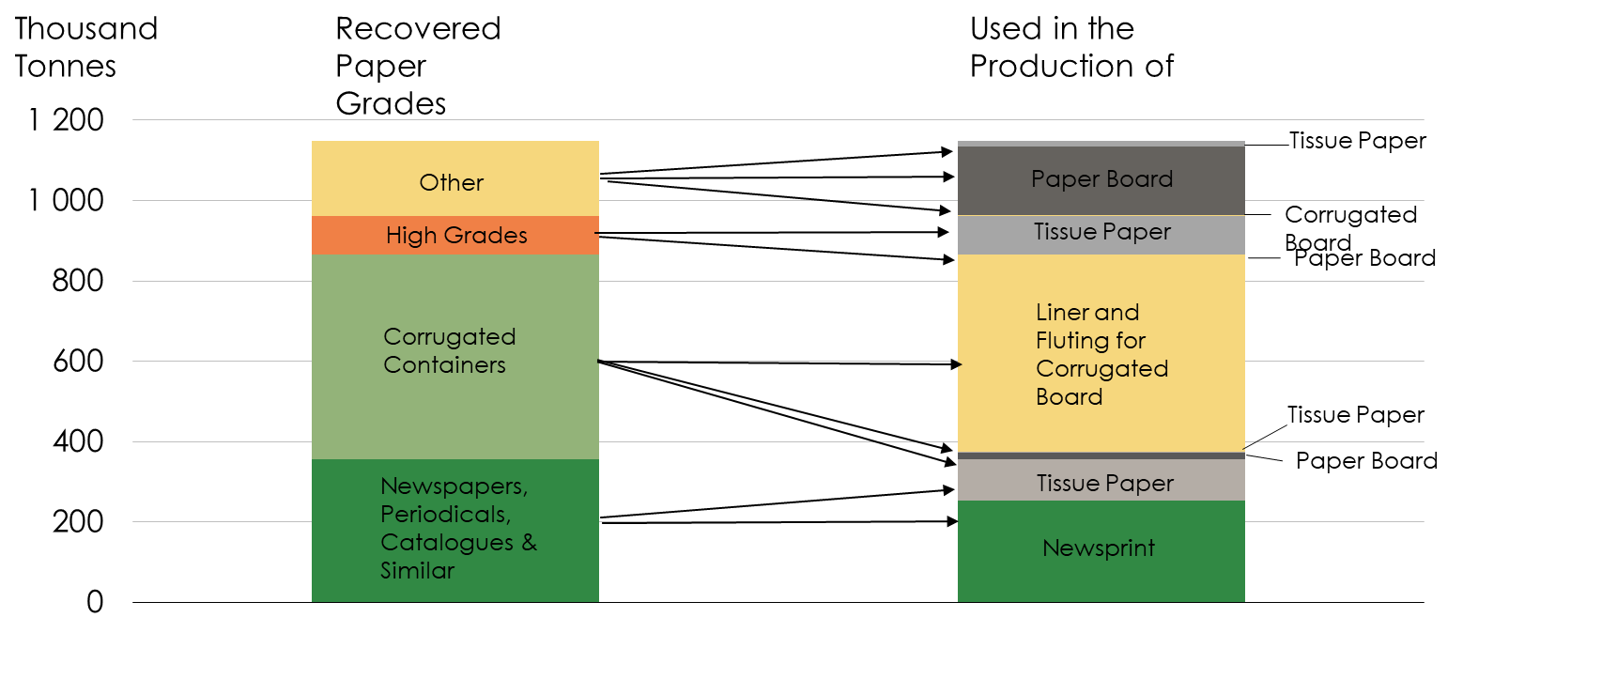
Recovered Paper as Raw Material in the Paper Industry 2018 Grades Recovered & Grades Produced

