Slide 1
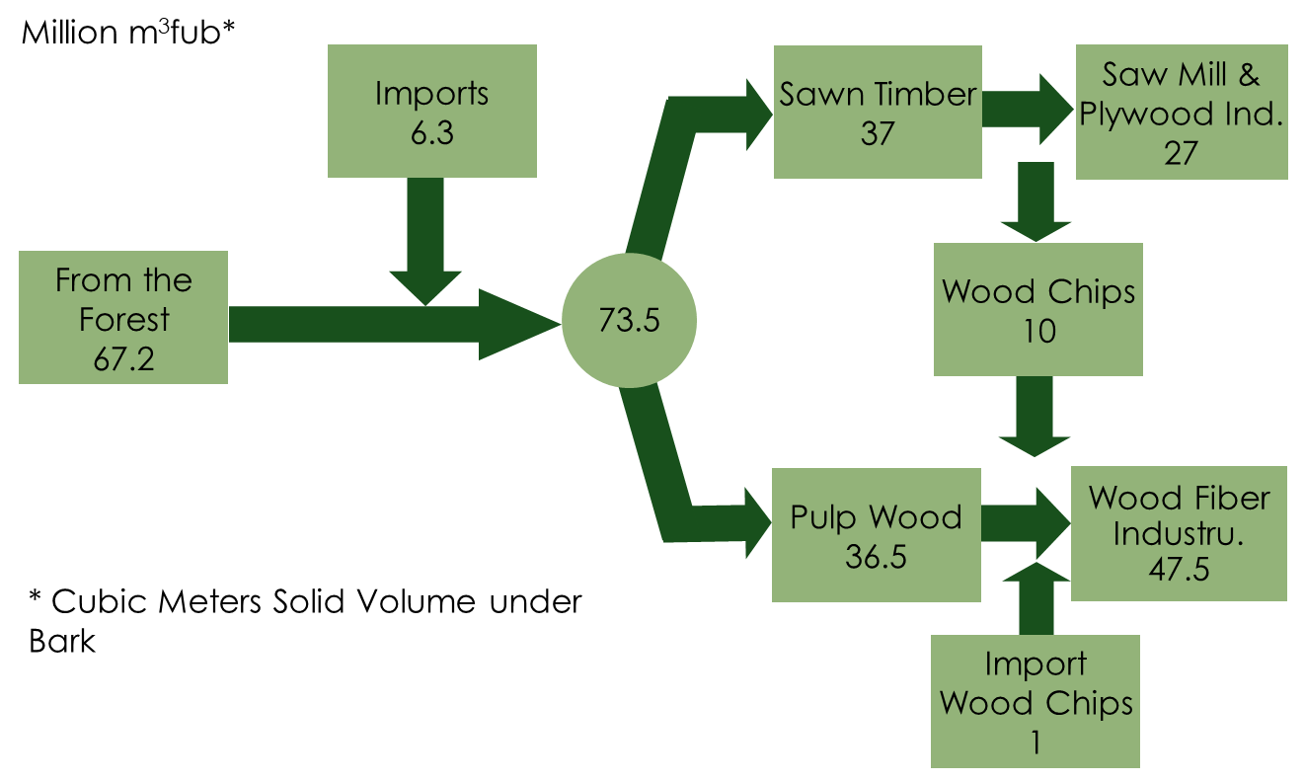
Wood Flow for the Forest Industries 2017
Source: VMR/SDC, Swedish Forest Industries Federation

Slide 2
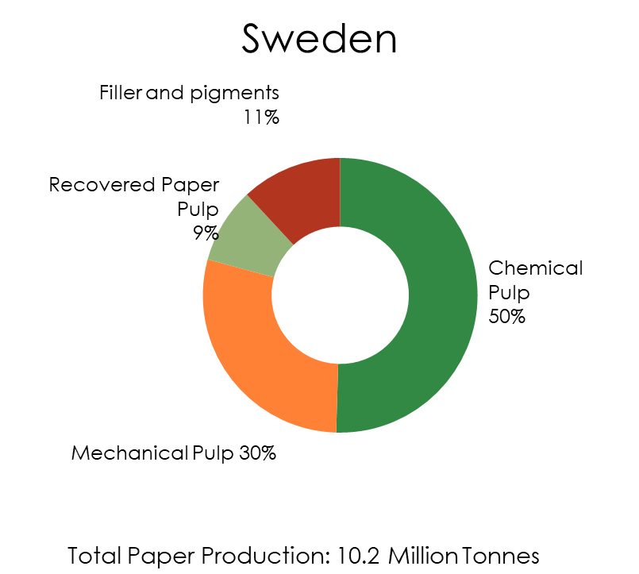
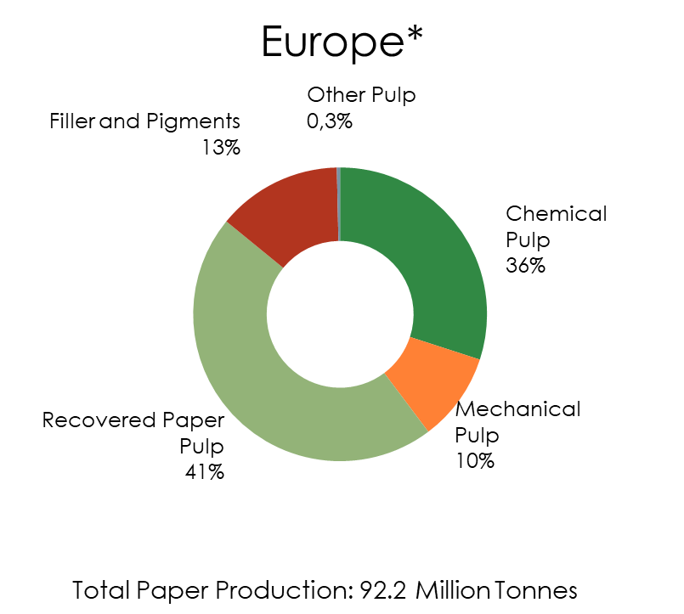
Raw Materials Used in Paper Production 2018
Source: CEPI
* Europe referred to CEPI

Slide 3
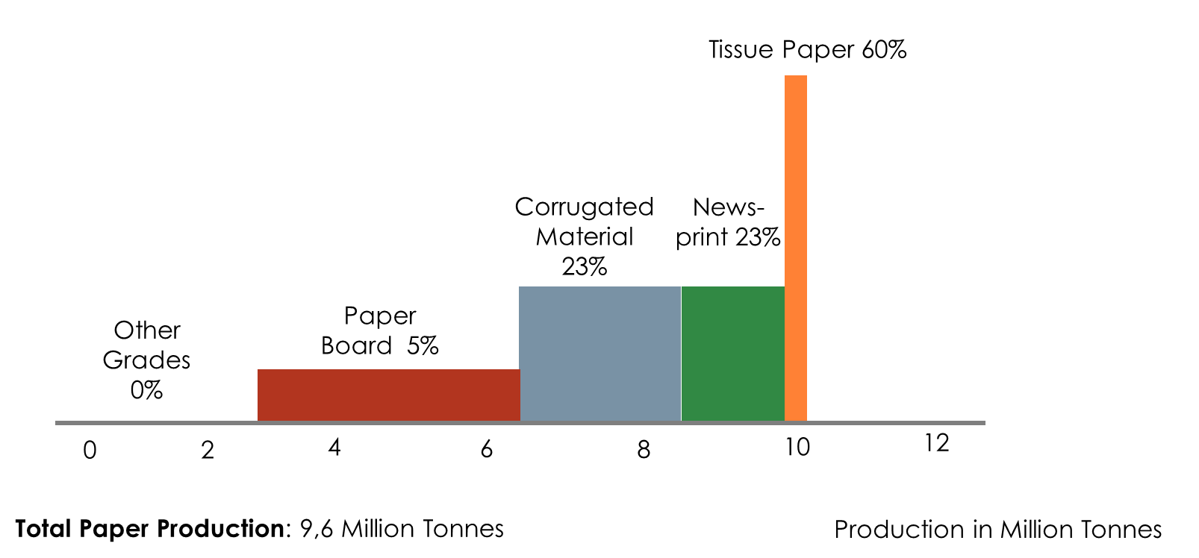
Utilisation Rate for Recovered Paper 2019 Various Paper Grades
Source: Swedish Forest Industries Federation

Slide 4
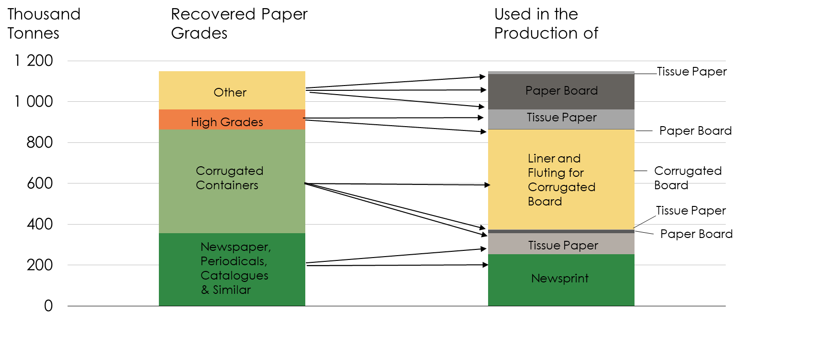
Recovered Paper as Raw Material in the Paper Industry 2019 Grades Recovered & Grades Produced

