Slide 1
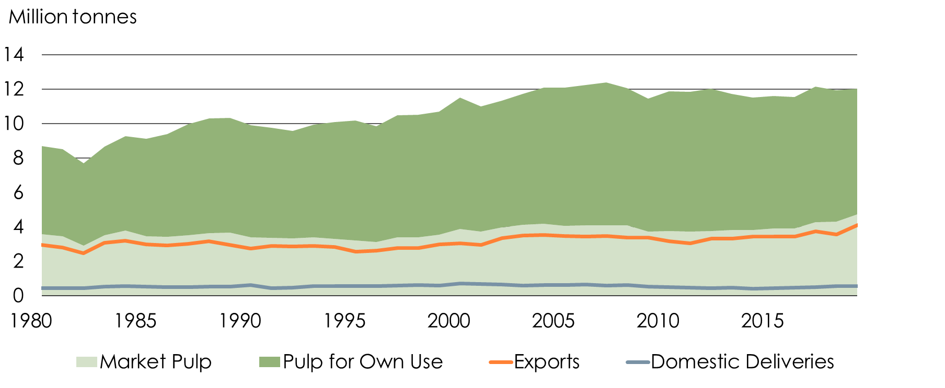
Pulp 1980-2019
Production and Deliveries

Slide 2
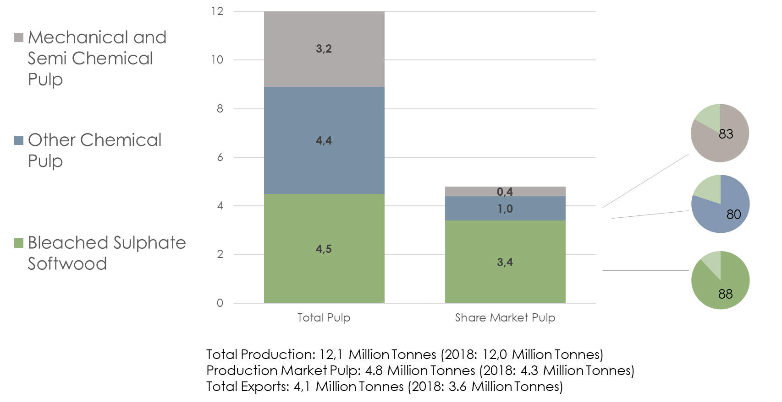
Production and Exports of Pulp 2019

Slide 3
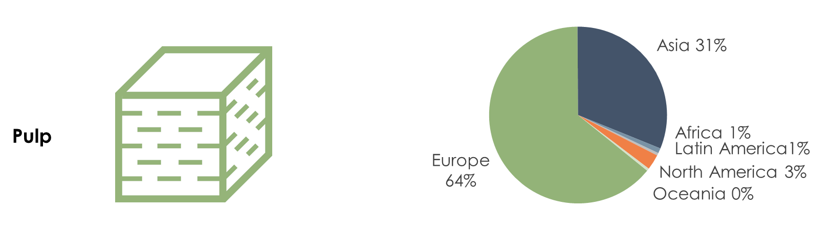
Europe is the Forest Industry’s Main Market 2019

Slide 4
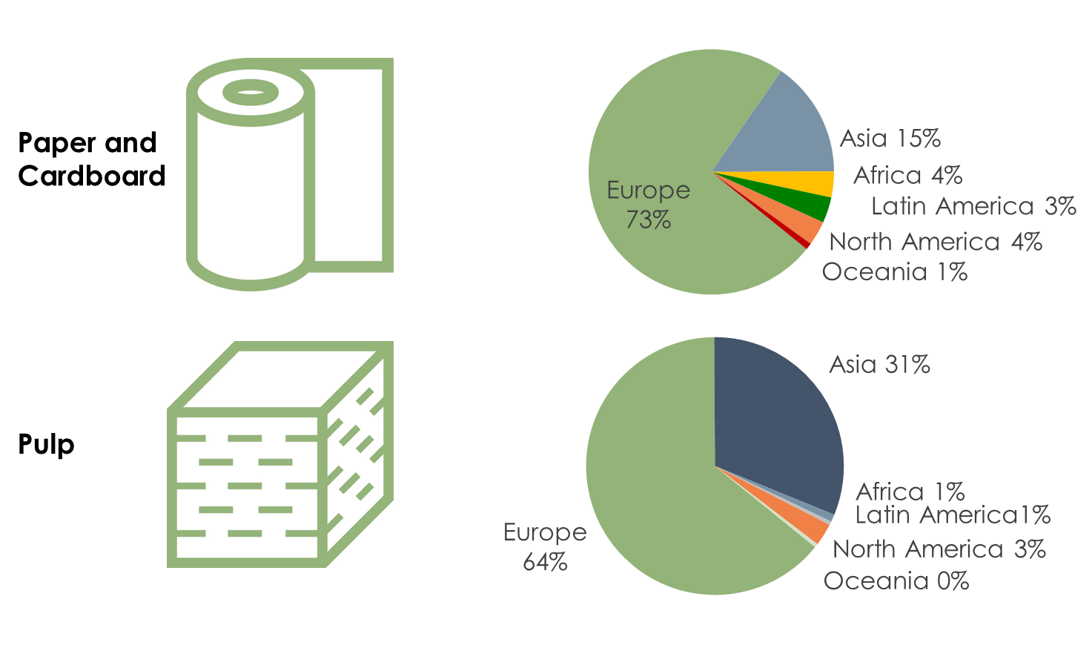
Europe is the Forest Industry’s Main Market 2018

Slide 5
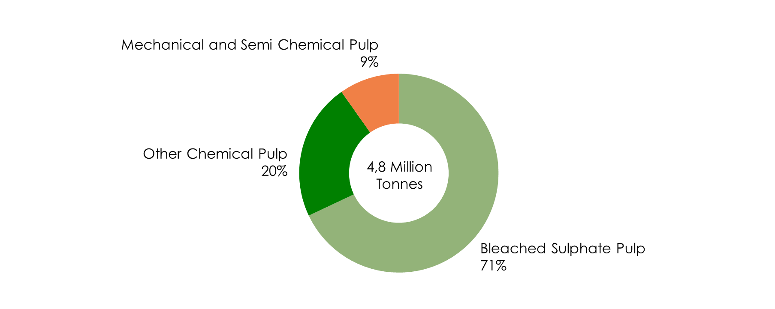
Production of Market Pulp in Sweden 2019

Slide 6
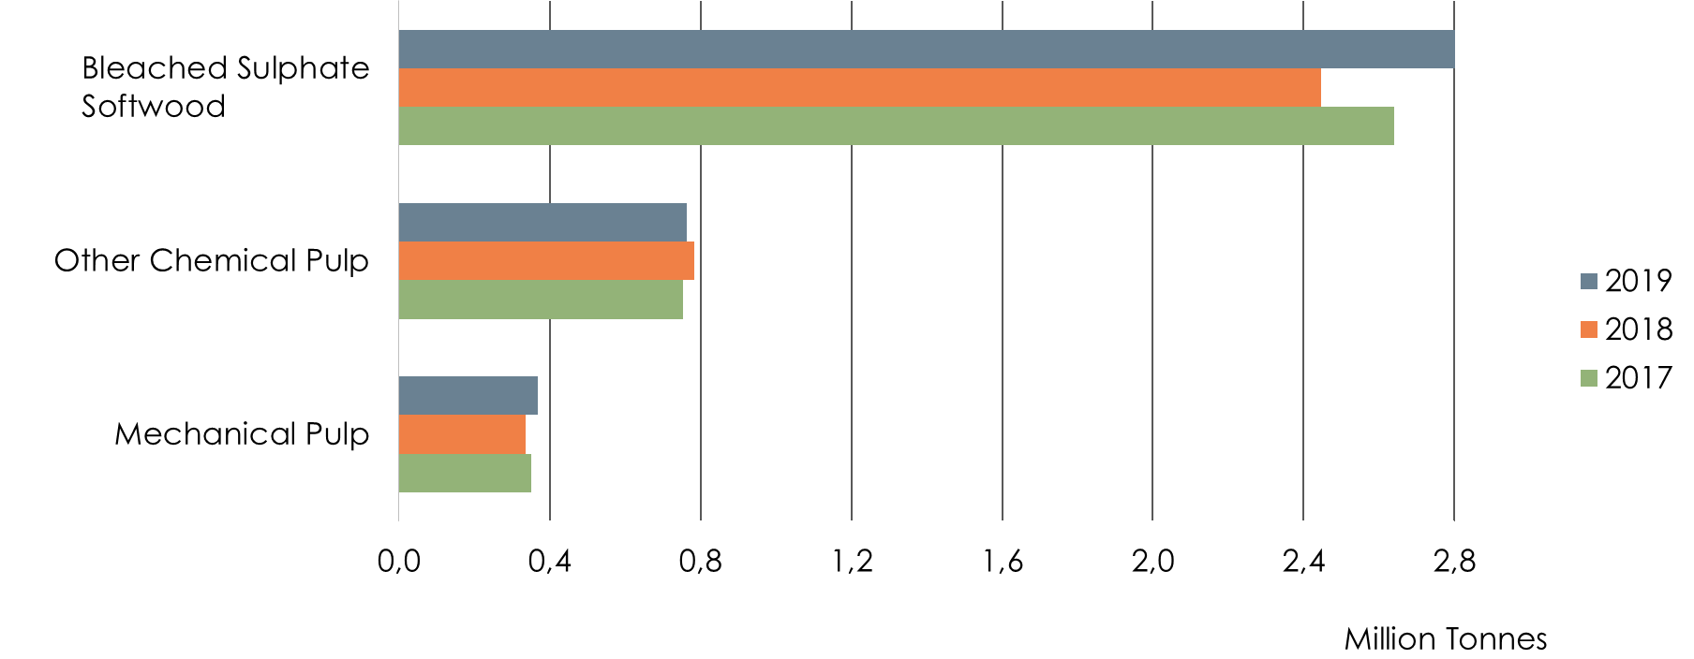
Exports of Pulp by Grade
Total Exports: 4,1 Million Tonnes 2019
3.6 Million Tonnes 2018
3.7 Million Tonnes 2017

Slide 7
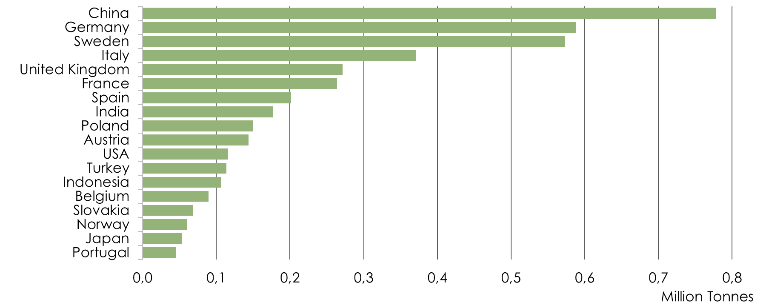
Pulp Deliveries by Market 2019
Total Deliveries: 4.7 Million Tonnes (2018: 4.2 Million Tonnes)
Total Exports: 4,1 Million Tonnes (2018: 3.6 Million Tonnes)
Total Exports for EU: 2.4 Million Tonnes (2018: 2.5 Million Tonnes)

Slide 8
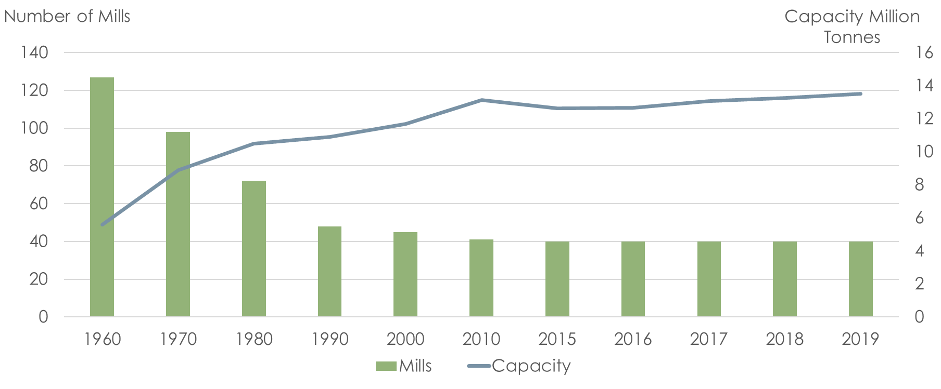
Structure Development in the Pulp Industry

Slide 9
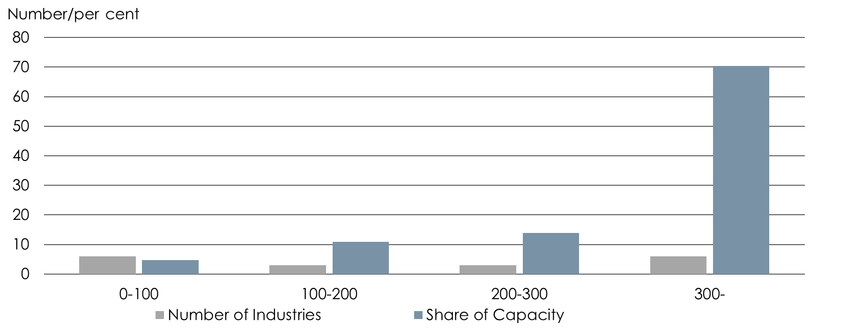
Structure of Market Pulp Production 2019

Slide 10
Pulp Production 2017-2019

Slide 11
Structural Changes Pulp 1980-2019

