Slide 1
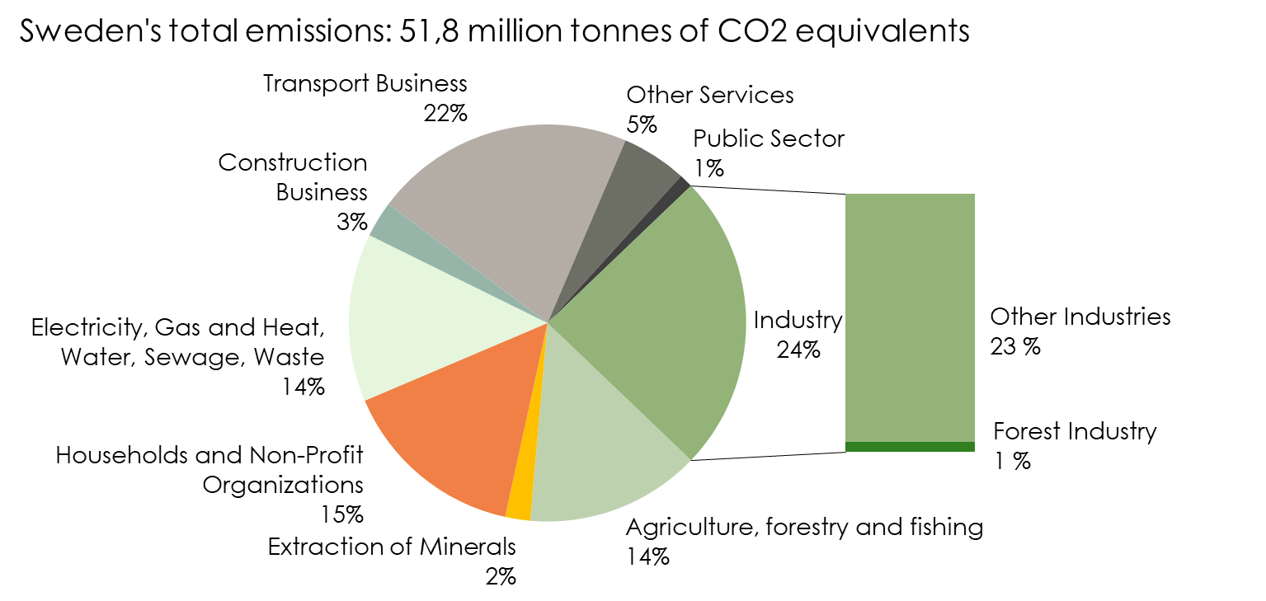
Sweden’s Emissions of Greenhouse Gases 2018 by Sector
Source: Swedish Forest Industries Federation, Environmental Protection Agency, Statistics Sweden

Slide 2
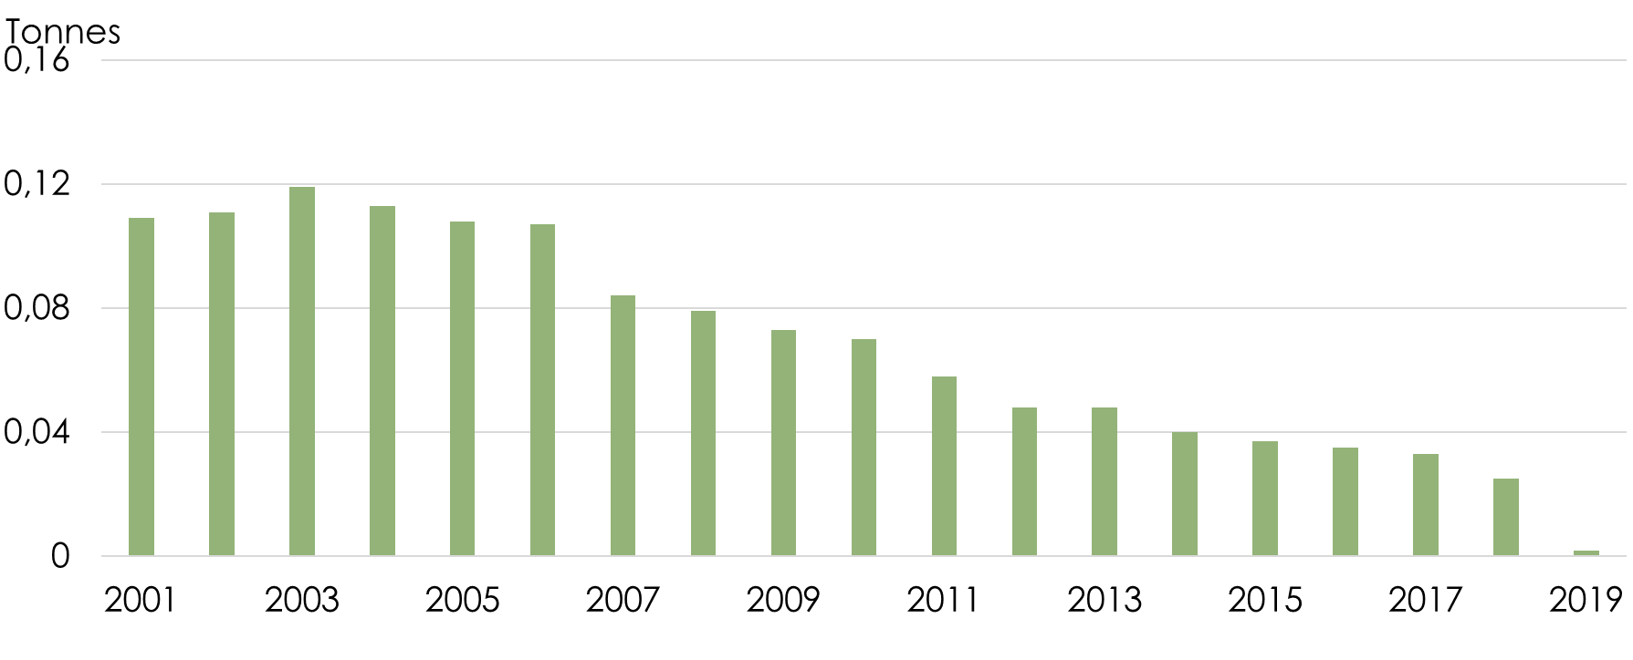
Carbon Dioxide Emissions (CO₂)* 2001-2019 per Tonne of Market Pulp and Paper
* Based on the forest industry's fossil fuel consumption
Source: Swedish Forest Industries Federation, Statistics Sweden

Slide 3
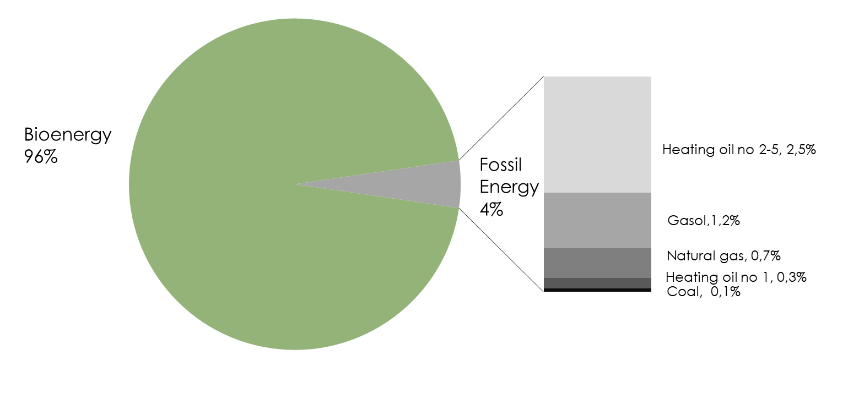
Fuel Consumption 2019 Pulp, Paper, Paper Products, Printing and Reproduction of Recorded Media
Source: Swedish Forest Industries Federation, Statistics Sweden

Slide 4
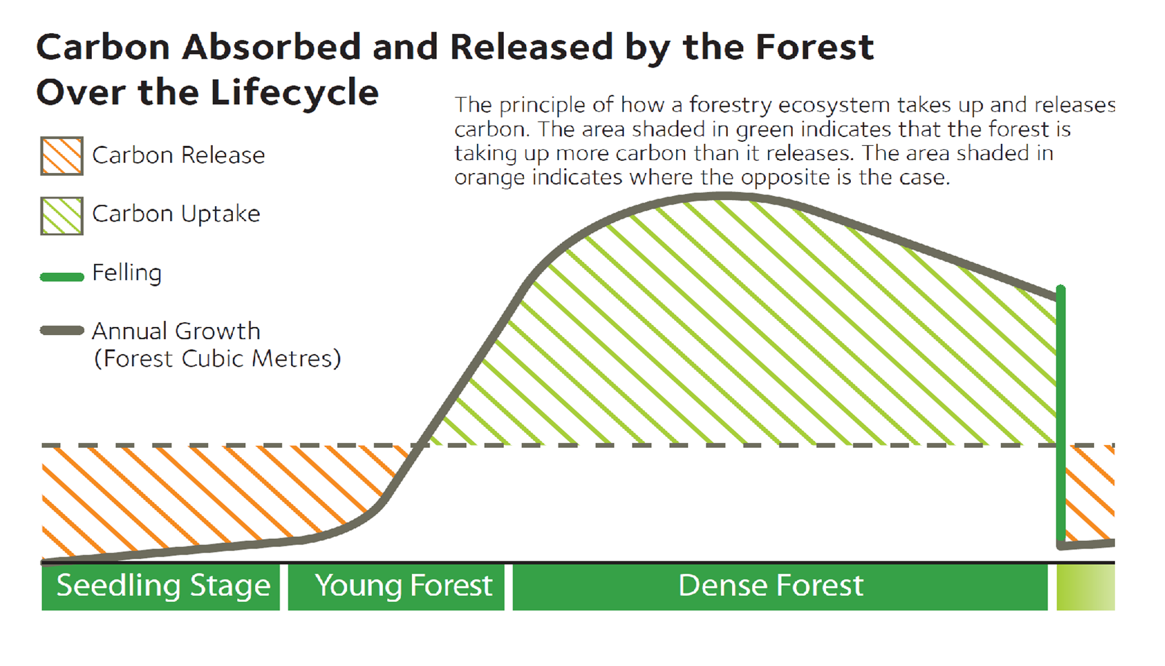
Source: SLU (The Swedish University of Agricultural Sciences)

