Slide 1
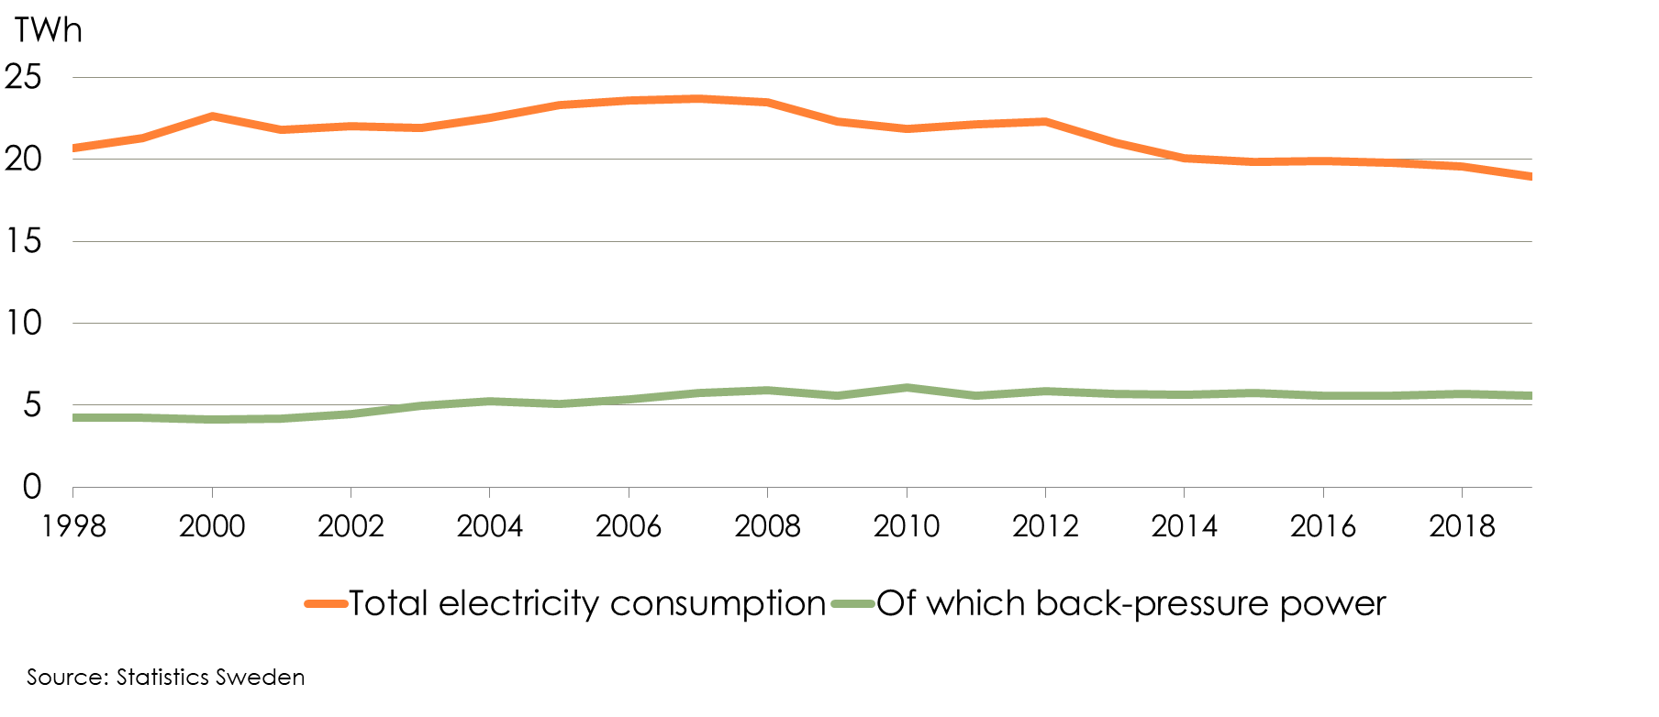
Electricity Consumption 1998-2019 The Pulp and Paper Industry

Slide 2
Fuel Consumption 2019 Pulp, Paper and Paper Products Industry and Graphic and other Printing Industries
Notes:
Sko

Slide 3
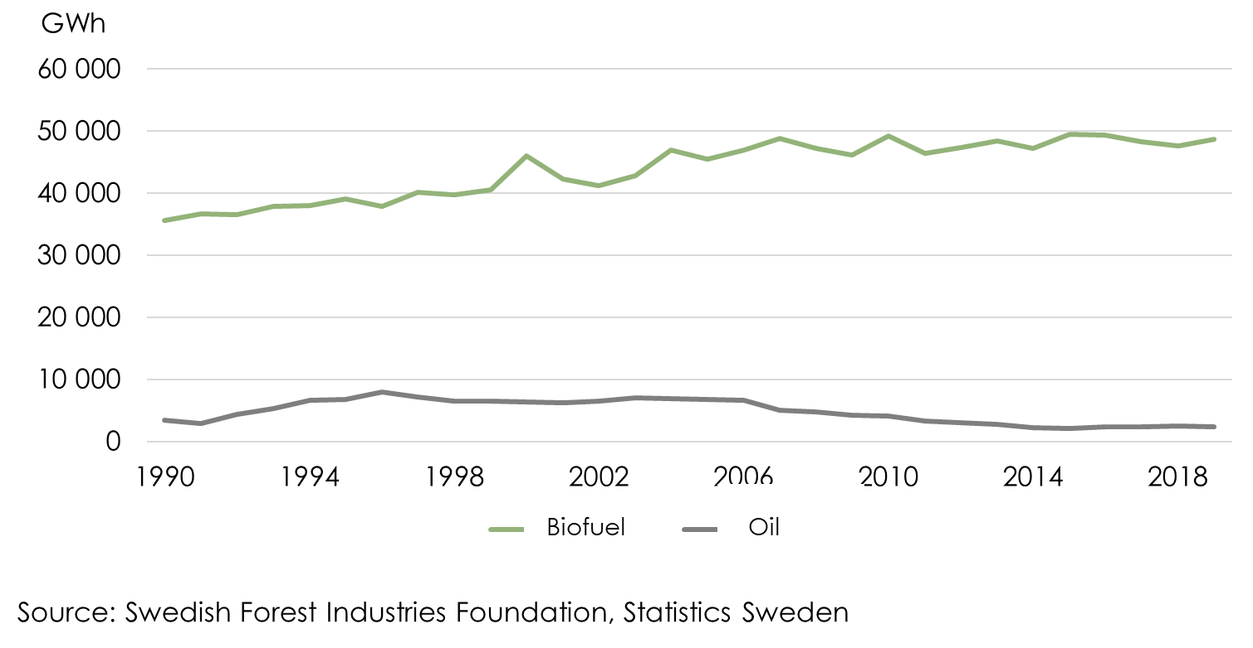
Annual Fuel Consumption in the Pulp and Paper Industry 1990-2019

