Slide 1
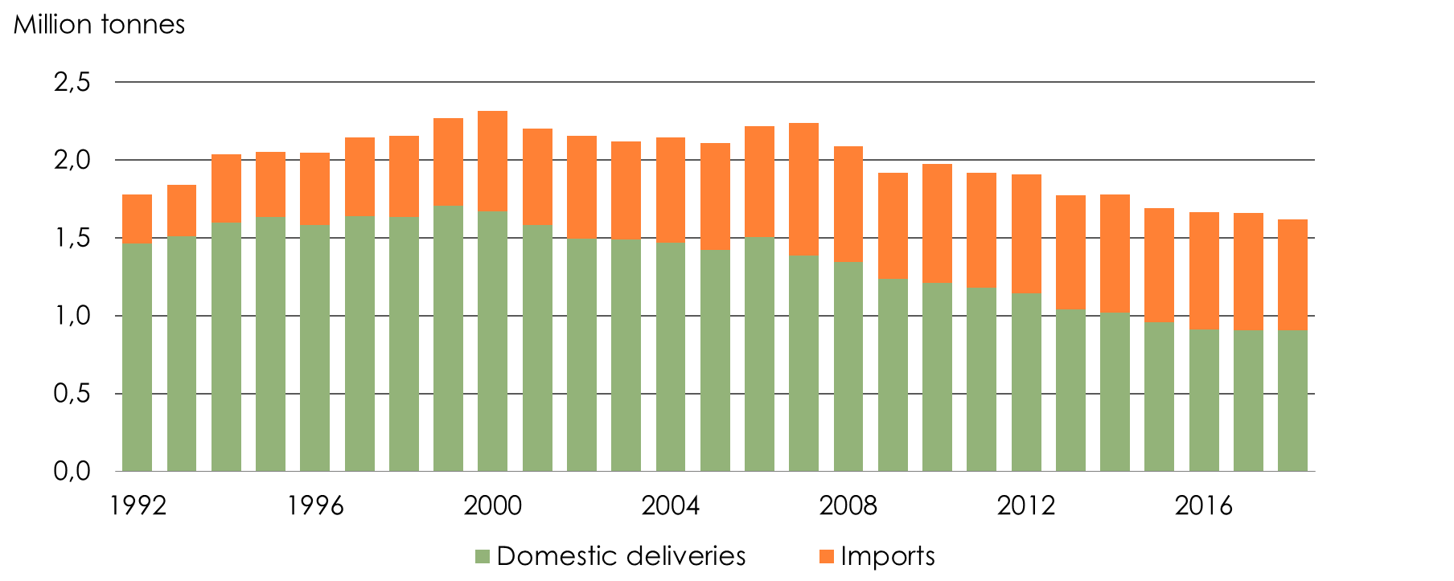
Paper consumption 1992-2018
Source: SCB, Swedish Forest Industries

Slide 2
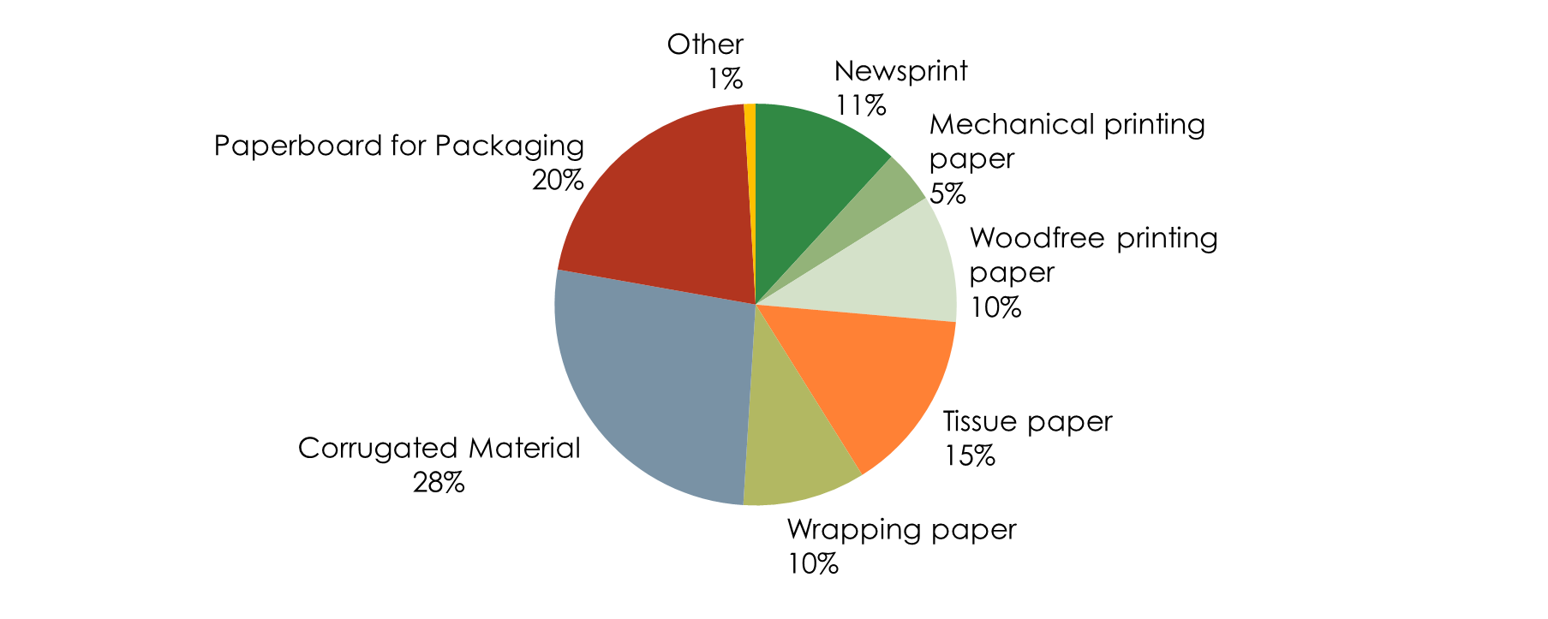
Paper consumption in Sweden 2019 Per quality

Slide 3
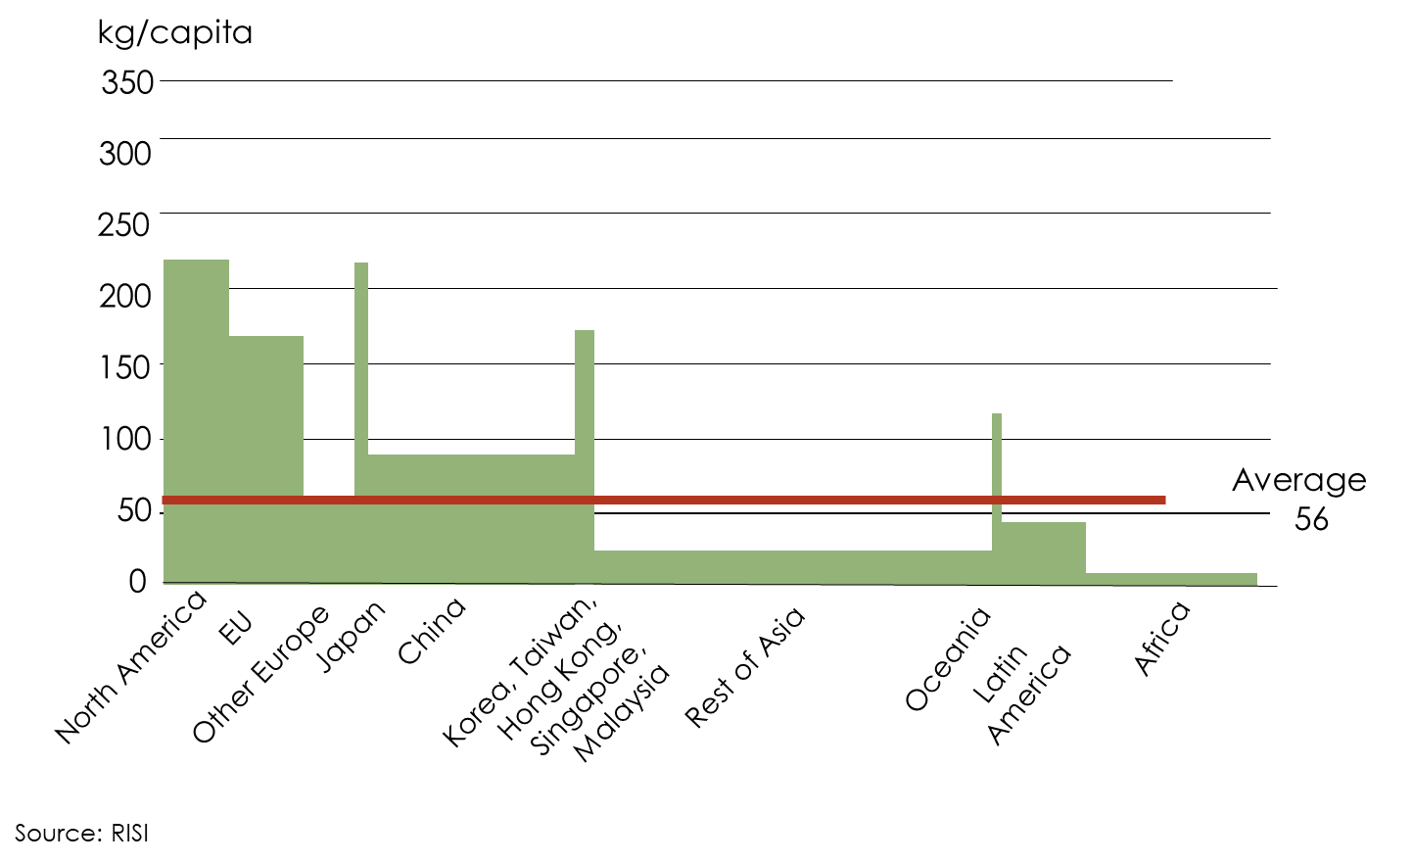
Paper consumption per capita 2018

Slide 4
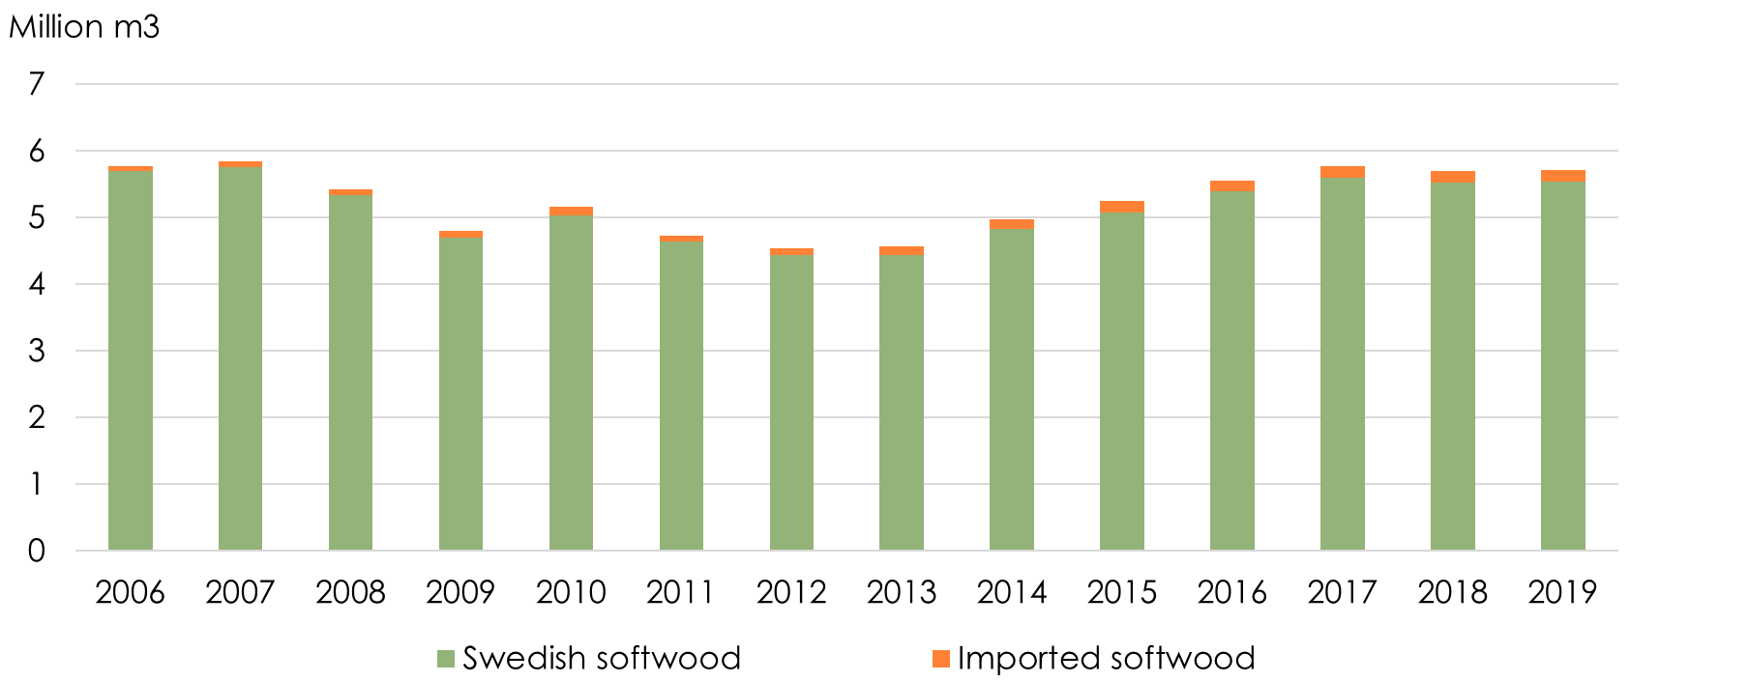
Sawn Softwood consumption in Sweden 2006-2019 (estimation)
Source: Swedish Forest Industries Foundation, SCB

Slide 5
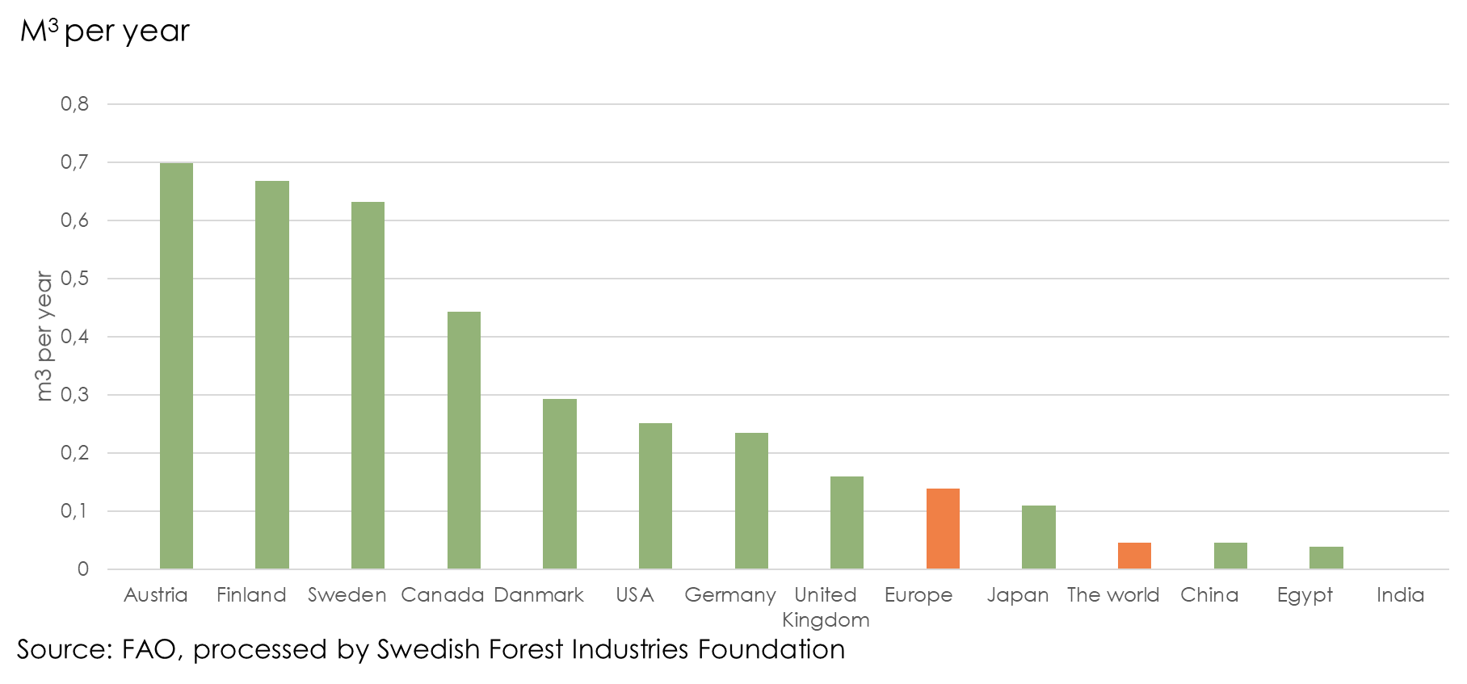
Consumption of Sawn softwood Per capita, 2018

Slide 6
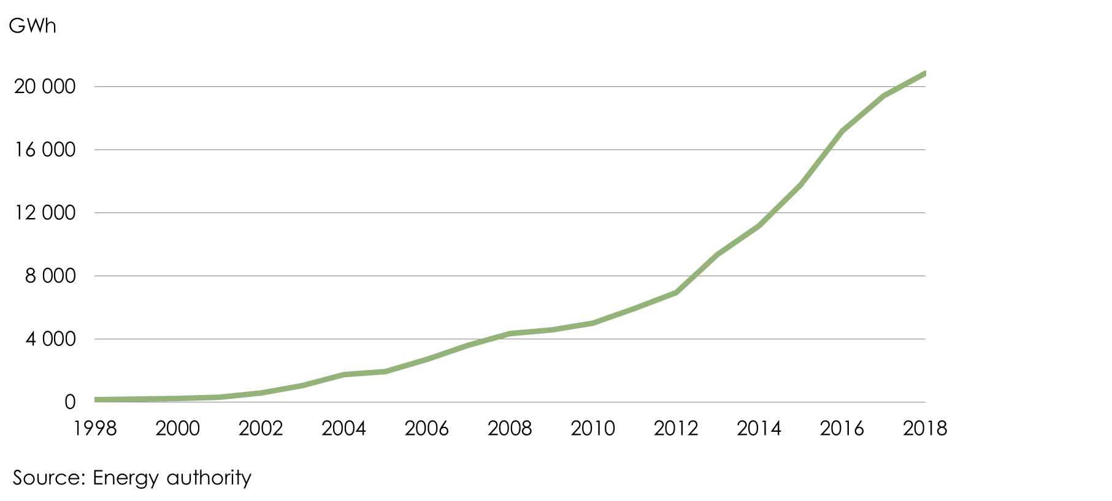
Biofuels in road traffic 1998-2018

